Slide 1
IMDB Ratings for MOVIES
GROUP 8
Himanshu Goyal (MBA/06/078)
Varun Nair(MBA/06/088)
Prachi Parekh (MBA/06/091)
Yashasvini Mathur (MBA/06/113)

Slide 2

INTRODUCTION
Most of the people prefer watching a movie after seeing their IMDb ratings.
There are many factors/variable deciding IMDb rating by an individual user collectively effecting the overall rating.

Slide 3
WHAT IS IMDb?
IMDB (Internet Movie Database) is an online database of information related to films, television programmes, video games, everything related to any segment that IMDB covers.
IMDB allows users to rate on the scale of 10. IMDB indicates that the submitted ratings are filtered, and weighted in various ways and weighted mean rating is calculated and that becomes the final rating for the movie.

Slide 4
CREDIBILITY FORMULA
The Top 250 films are also based upon credibility formula. Current formula is not disclosed but earlier the formula used by IMDB was
W= (R×v + C×m) / (v + m)
Where,
W= weighted rating
R= Average for the movie as a number from 1 to 10 (mean)
v= Number of the votes for the movie
C= mean vote across whole report
m= minimum votes required to be listed in Top 250

Slide 5
KEY OBJECTIVES
The primary objective of this study is to examine the effect of various factors on the IMDB rating of a movie by observing the correlation and using the factors having higher correlation for predicting the IMDB rating of a movie using a multiple regression equation.
The secondary objective of the study is to analyze the ratings of each genre.

Slide 6
SECONDARY DATA
DESCRIPTION OF DATA
“IMDB 5000 Movie dataset” is taken from Kaggle and analyzed based using the numerical attributes of the dataset due to the constraints of the software used i.e. MS Excel.
Data was cleaned manually and missing values were eliminated from the data.
A sample was selected from the data using Convenience Sampling – Data for 10 years (2006-2016) was used for analysis which included records of 1674 movies.
The data before cleaning had 5675 rows and 28 attributes.
CATEGORICAL- 13
NUMERICAL - 15

Slide 7
METHODS USED
01
03
02
04
03
Correlation
General Max-Min
Analysis
Descriptive statistics
Regression analysis

Slide 8
GENERAL MAX-MIN ANALYSIS
The highest number of movies released during 2006 and lowest during 2016.
Action movies were released the most and Romance movies were the least released ones.

Slide 9
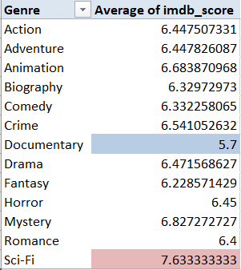
GENERAL MAX-MIN ANALYSIS
The Documentary genre - lowest average IMDB rating - 5.7 Sci-Fi - highest average IMDB rating - 7.63.
The average is highly affected by the number of observations used.
There are cases in other genres where the number of movies were more and the average rating is a more reliable factor for consideration for evaluating the likeness of a genre by the users.

Slide 10
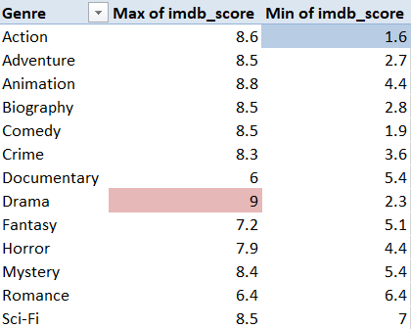
GENERAL MAX-MIN ANALYSIS
The Lake HouseÂ is the highest rated movie of IMDB score 9 and belongs to the Drama genre.
The Great RaidÂ is the lowest rated movie of IMDB score 1.6 and belongs to Action genre
The highest and lowest movie do not belong to either of the genres having highest and lowest average IMDB score. This explains that averages are not useful for analyzing the extreme values in a data.

Slide 11
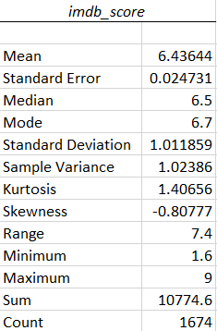
DESCRIPTIVE STATISTICS
IMDB score has an average of 6.43 from 2006-2016 and median of 6.5 and standard deviation of 1.011.
IMDB score is left skewed with -0.80 skewness and have a higher peak than normal distribution with kurtosis of 1.40

Slide 12
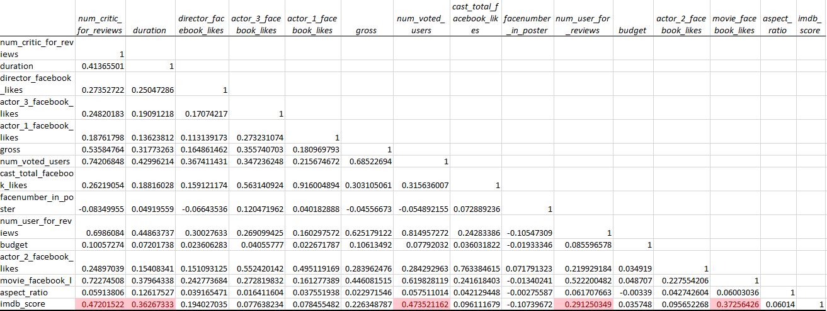
CORRELATION
The correlation matrix shows positive relationship between IMDB score and other variables but only the variables with highest correlation are considered and they are: - num_critic_for_reviews; duration; num_voted_users; num_user_for_reviews; movie_facebook_likes.

Slide 13
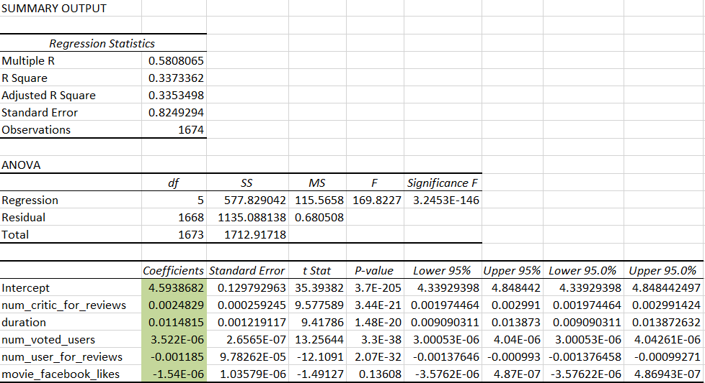
REGRESSION
Equation of the regression is: -
Y = 4.59 + (0.0025)x₁+ (0.011)x₂ + (3.25×10⁻⁶)x₃ + (-0.0012)x₄ + (-1.5×10⁻⁶)x₅
With adjusted R square as 0.3353, it shows that only 33.53% variation can be explained by model inputs rest other categorical variables affect the IMDB score

Slide 14
CONCLUSION
Documentary genre has the lowest average IMDB rating of 5.7 and Sci-Fi has the highest of 7.63
Movies of action genre have the highest number of releases and also an average rating of 6.4 which means that people are fairly fond of action movies.
The IMDB score is not just affected by the numerical attributes of the given data, but is also affected by the categorical attributes, which if considered could have resulted in a more efficient model of prediction.

Slide 15
THANK YOU

